Slide 1

Living Room Conversations:
Talking about Our Hurts and Fears
Darlene Cain and Kate Towle

Slide 2



Our “Sphere of Perspective”
We see things from different lenses.
We’re at different stages in our development with our “peace literacy.” We’re each doing different math.
We need to find the math we can do together.

Slide 3
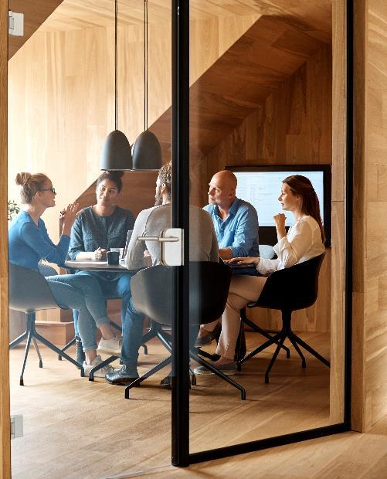

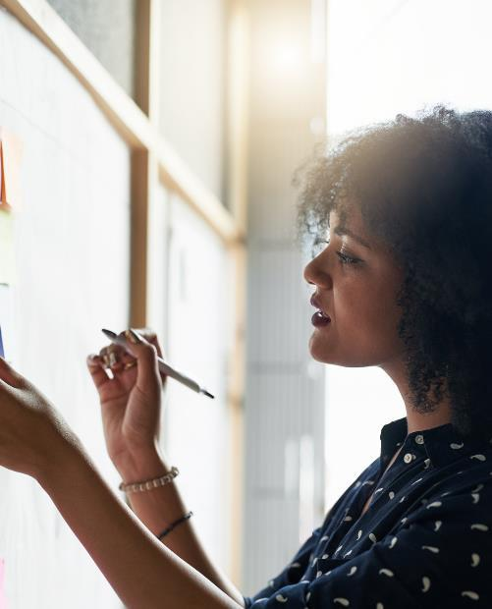
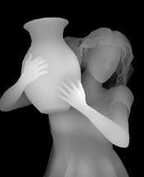
Making Sense
We each see things differently. That determines our focus. The more we gain other perspectives, the more we can see the depths and context in weaving.

Slide 4

We’re each doing different math:
We work from where we can see clearly. Whether we are learning addition/subtraction, multiplication/division, fractions or algebra, we work from where we are. It’s a development issue! So is building understanding.

Slide 5
Joining the Table for Group Discovery
David Brooks: A good conversationalist is capable of leading people on a mutual expedition toward understanding.
Co-regulation and self-care. Seeking peace within: nature walks; breathing and meditation; boundaries; nutrition; finding a trusted friend; dance; reading; folding origami
Creating a space for discovery – alone and with others.
Just as we approach the part of us that holds tension in meditation, we can also hold the tension of differences.
We have the strength to name the thing that hurts and bring it into conversation: war and nuclear disarmament, gun violence, climate justice, racial and social justice; family crisis.

Slide 6
Living Room Conversation:
Respect. Relate. Connect.
Introductions: Why We’re Here. (Your name and what drew you here.) 10 minutes
Conversation Agreements (5 minutes)
Conversation Rounds: what we’ll talk about. In the interest of time, we’ll talk about caregiving in systems with a severed social net.
Round One: Getting to Know Each Other: What would your best friend say about you?
Round Two: Exploring the Topic (40 minutes): Introduction and Query
Round Three: Reflecting on the Conversation (15 minutes): What learning, new understanding or common ground was found?
Closing (5 minutes): Give us feedback. Donate. Join or host more conversations.

Slide 7
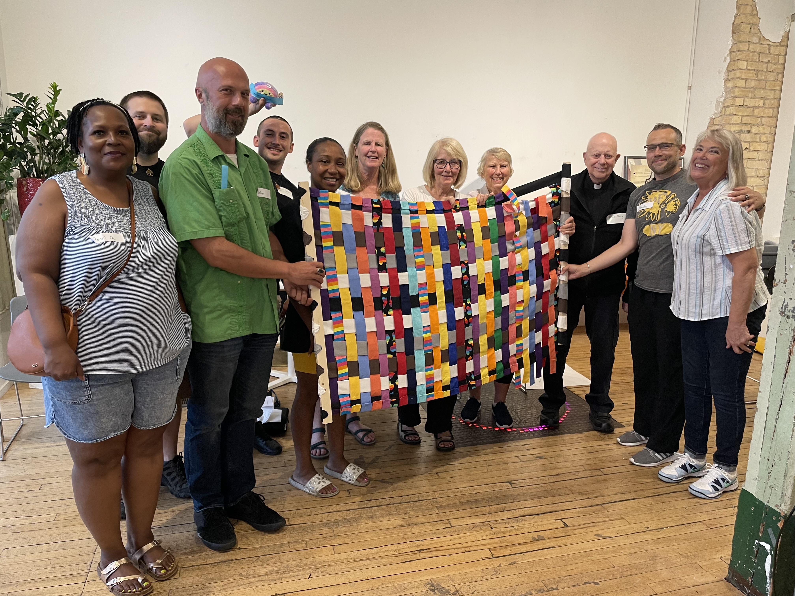
The Three Elements of Universal Respect (Paul K. Chappell):
Listen.
Speak to the other person’s highest potential.
Practice what you preach.

Slide 8

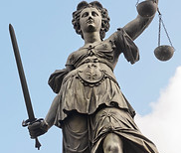
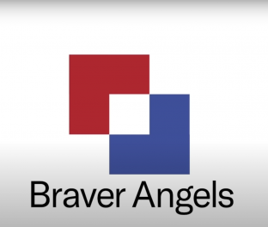
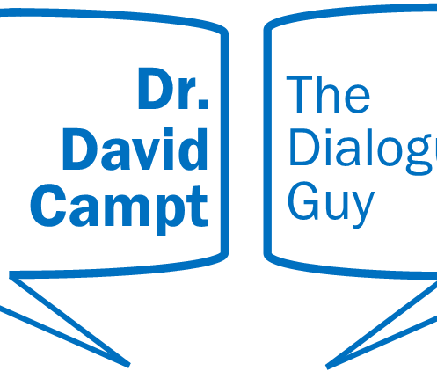
Other Approaches:
Nonviolent
Communication:
https://www.cnvc.org/
Peace
Literacy
Institute:
Peaceliteracy.org
Braver Angels:
https://braverangels.org/
Dr. David Campt’s
White Ally Toolkit:
www.davidcampt.com

Slide 9

Summary
It’s important to spark conversations that honor our hurts and fears, while also honoring where everyone’s at in their developmental journey. We can discover together any of these methods of building transformative discourse. Dialogue helps us set the course for action!

Slide 10

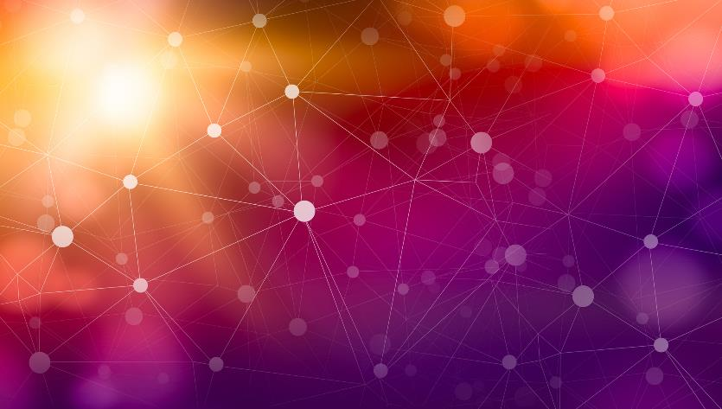
Thank You
Darlene Cain: dcain201049@yahoo.com
Kate Towle: kteemuse@gmail.com
www.sweetburdenofcrossing.org

